Slide 1
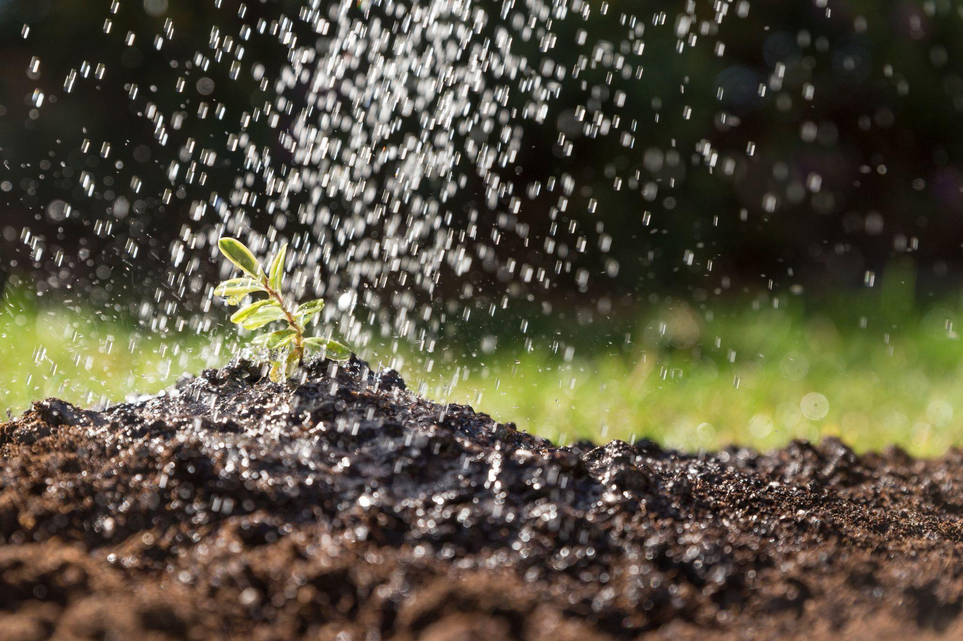
GARDEN IRRIGATION SYSTEMS
Efficient Watering Solutions for a Greener Future

Slide 2
TABLE OF CONTENTS
01
04
02
05
03
06
Introduction
Objectives
System Architecture
Methodology
Hardware & Software Requirements
Conclusion

Slide 3
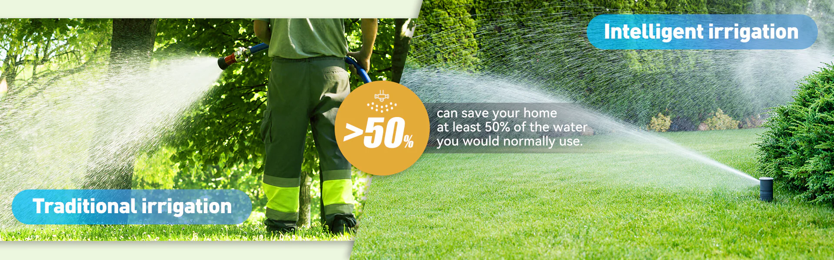
Introduction & Project Overview🌱
💧 Problem Statement: Old watering methods waste water and need a lot of manual work, which is not efficient and takes up time.
🔧 Why This Project is Important?
Automates watering, so you don’t need to do it manually.
Saves water by only watering when needed, based on the soil moisture.
Helps plants grow better and is good for the environment and your wallet.
Applicable for home gardens, farms, and greenhouses.

Slide 4
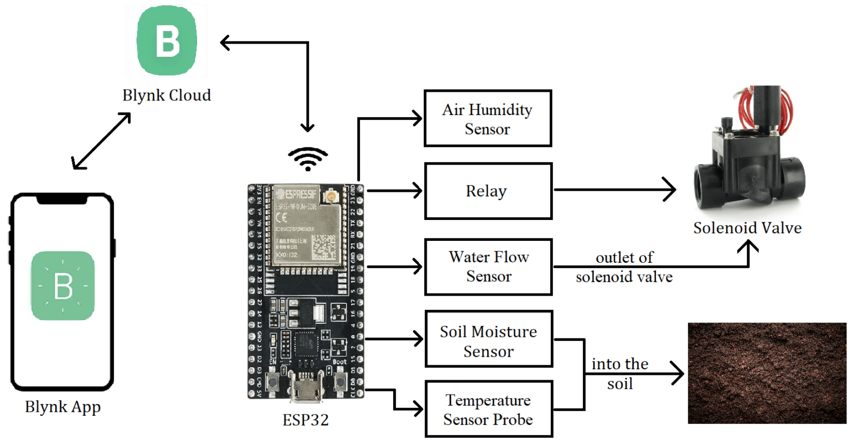

Slide 5
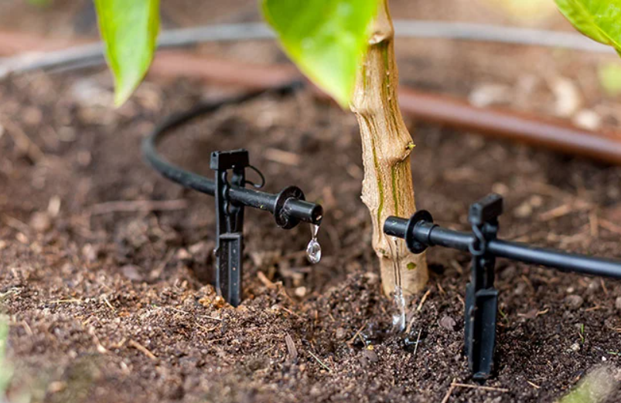
Problem Identification & Motivation
Problem Statement:
Traditional irrigation systems depend on manual work, which takes a lot of time and can be inefficient.
Water wastage is a big issue with these systems because water isn’t always used in the best way.
Sometimes the water is not spread evenly, leading to some plants getting too much water and others too little, which harms their growth.
Need for Automation:
Automated systems help manage watering better, ensuring that water is given only when and where it's needed.
Automation reduces the need for people to water the plants manually and makes the process more reliable and consistent.

Slide 6
Problem Solving with Our System
How Our System Solves Problems:
Our system automates irrigation, ensuring water is used efficiently, reducing wastage.
It monitors soil moisture and adjusts watering, so plants get the right amount of water at the right time.
Benefits of Automation:
Saves time by eliminating manual watering.
Reduces water wastage, making irrigation more sustainable.
Improves plant health by ensuring consistent watering.
Lowers water costs by using less water.
Real-World Application:
The system can be used in home gardens to save water and maintain healthy plants.
It can also be applied in farms and greenhouses to increase crop yield while conserving water.

Slide 7
Research & Related Work
Review of Existing Solutions:
Traditional irrigation methods like drip irrigation and sprinkler systems are commonly used, but they have limitations:
Drip Irrigation: Only targets specific areas, but can be inefficient over large areas.
Sprinkler Systems: Can cause water wastage due to over-spraying and uneven coverage.
Technologies in Use:
Sensors: Used to monitor soil moisture, temperature, and weather conditions.
Wi-Fi-Controlled Systems: Allow remote control of irrigation through mobile apps or computers.
Weather Forecasting: Some systems adjust watering based on weather predictions to avoid watering during rain.
Research Papers:
A study by [Author Name] (Year) shows that smart irrigation systems can save up to 30% more water compared to traditional methods.
Research from [University Name] shows that integrating weather forecasting with irrigation can reduce water consumption and improve crop yield.

Slide 8
System Design & Components
Overview of the System:
The system consists of sensors, a controller, and actuators working together to automate irrigation.
A flowchart or block diagram can show how the components interact (e.g., sensors detect soil moisture → data sent to the controller → actuator opens valve/pump to water plants).
Key Components:
Sensors:
Soil Moisture Sensor: Measures the moisture level in the soil to determine if watering is needed.
Temperature Sensor: Monitors the temperature, as extreme heat can increase water needs.
Actuators:
Valves and Pumps: Control the flow of water, opening or closing based on the system's requirements.
Controller (Microcontroller):
Arduino/Raspberry Pi: Acts as the brain of the system. It collects data from sensors and controls the actuators.
Equipments Used:
Hardware:
Soil moisture sensors, temperature sensors, valves, pumps, and microcontroller (Arduino/Raspberry Pi).
Software/Algorithms:
The system uses basic algorithms to determine when to water based on sensor inputs.

Slide 9
Implementation & Testing
Setup Process:
Assembling the System: Connect the soil moisture sensor, temperature sensor, valves, and pumps to the microcontroller (Arduino/Raspberry Pi).
Sensor Installation: Install the soil moisture and temperature sensors in the garden or farm to measure the conditions.
Controller Configuration: Program the microcontroller to read sensor data and control the actuators (valves and pumps) based on the conditions.
Testing Results:
System Functionality: Test if the system responds to different moisture levels and adjusts watering accordingly.
Data Collected: Record how much water is used and compare it with the water requirements of the plants.
System Efficiency: Check how the system conserves water compared to traditional irrigation methods.
Challenges Faced:
Sensor Calibration: Initial calibration of sensors to ensure accurate readings.
Connectivity Issues: Addressing any connection issues between sensors, actuators, and the microcontroller.
Software Bugs: Fixing any software errors that caused the system to behave unexpectedly (e.g., watering too much or too little).

Slide 10
Conclusion & Future Scope
Conclusion:
The automated garden irrigation system offers an efficient and sustainable solution for watering plants.
It saves time, reduces water wastage, and ensures healthier plants by providing the right amount of water at the right time.
This system can be used in home gardens, farms, and even commercial landscaping to improve water management.
Future Scope:
AI Integration: Use artificial intelligence to predict watering needs based on weather patterns and plant types.
Mobile App Control: Develop a mobile app to allow users to control and monitor their irrigation system remotely.
Advanced Sensors: Implement more advanced sensors for more precise water management, such as humidity and light sensors.
Smart Watering Schedule: Integrate a feature that adjusts watering schedules automatically based on real-time data from sensors and weather forecasts.
Impact:
The system contributes to sustainable gardening and water conservation, making it an important step towards environmentally friendly gardening practices.
It can also help reduce costs for users by optimizing water usage and reducing the need for manual labor.

Slide 11
THANKS!

